Slide 1
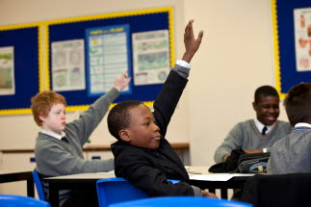
Why do some disadvantaged children succeed ‘against the odds’?
Evidence from the EPPSE project

Slide 2
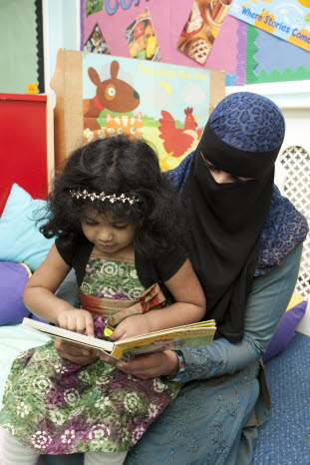
What is EPPSE?
EPPSE is the Effective Pre-School, Primary and Secondary Education Project.
It is a longitudinal study that has followed 2,500 children from the age of 3 through pre-school, primary and secondary school.
This sub-study used attainment data between the ages of 3 and 11 to identify children who were over- or under-achieving at the end of Key Stage 2 (relative to background characteristics). Fifty children (24 girls, 26 boys) were interviewed when they were aged 14-16, as were their families and some of their teachers.

Slide 3
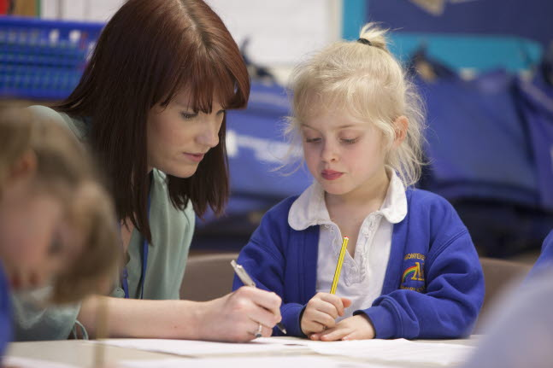
What is the problem that this study explored?
Disadvantaged children generally do less well at school
Only one in five young people from the poorest families achieve five good GCSEs, including English and maths, compared with three quarters from the richest families¹.
25% of children from poor backgrounds fail to meet the expected attainment level at the end of primary school, compared to 3% from affluent backgrounds¹.
However, many children from disadvantaged backgrounds do succeed. This EPPSE study explores the reasons why.
1- Source: Social Mobility Strategy, 2011

Slide 4
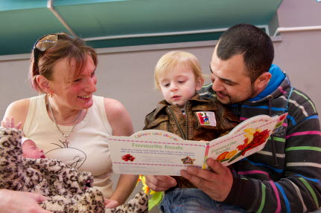
Disadvantaged children who succeeded against the odds were helped by their parents
These parents:
engaged their young children as much as they could (reading, talking about school, cooking together etc),
positively valued learning and had high regard for education. If they had a gap in their own knowledge they found others who could help,
set and reinforced high standards, both for behaviour and academic aspiration,
encouraged extra-curricular activities explicitly for learning and development (whereas other parents saw them just as fun and relaxing).

Slide 5
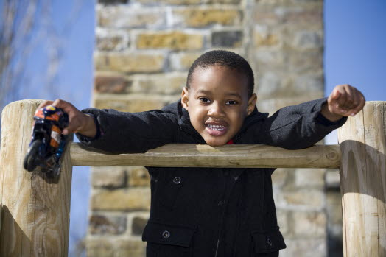
They were encouraged and nurtured in pre-school
Most parents believed that pre-school fostered social skills, however those whose children made fast progress saw its value for developing literacy and numeracy and preparing children for school routines.
They also believed that pre-school offered their child something in addition to what they could offer at home.
Disadvantaged boys were particularly helped by attending high quality pre-school: those from excellent pre-schools (in this small sub-sample) went on to succeed above expectation.

Slide 6
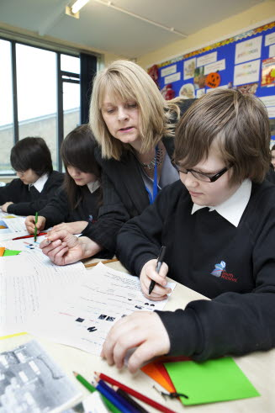
They had a positive self-image
Children who succeeded viewed themselves as clever. They had a positive attitude towards homework, and a positive image of themselves as learners which was continually reinforced at home and in school.
Children who experienced difficulties with learning or were not seen as clever developed a negative self-image.
This was reinforced by the perception of parents (and children) that ‘ability to learn’ was ‘a given’ rather than something that could be shaped, and as a result parents (and schools) made little effort to remedy the difficulties children experienced.

Slide 7
They had good quality teaching at school
Children (and their parents) who made fast progress attributed part of their success to the quality of their primary teachers who they felt:
were able to explain topics and lessons clearly
were enthusiastic about the subject they taught,
were approachable when things were difficult to understand,
had control over the class and clearly communicated their expectations and boundaries, and
encouraged children to work to achieve beyond their predicted attainment.
Those who did not succeed partially blamed discontinuity and disorganised lessons caused by high numbers of supply teachers.

Slide 8
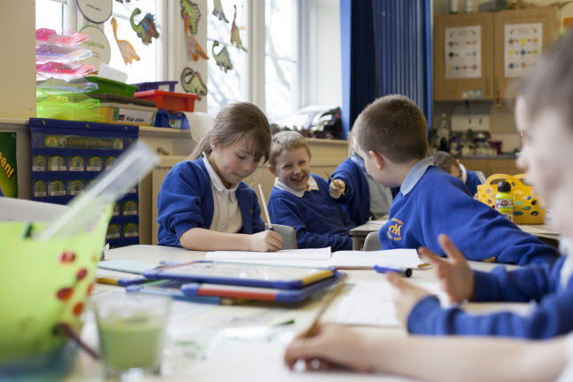
They had support from school if there were problems
The successful children felt they had support from school when they were experiencing difficulties with academic work or behaviour.
Support included appropriate homework, booster, revision or behavioural classes.
This helped children to catch up, (re)establish and reinforce a positive perception of school and learning.
In contrast, those who fell further behind felt let down by schools and teachers.
Some parents felt frustrated and even angry with schools for not helping their children, and these negative perceptions were transmitted to children.

Slide 9
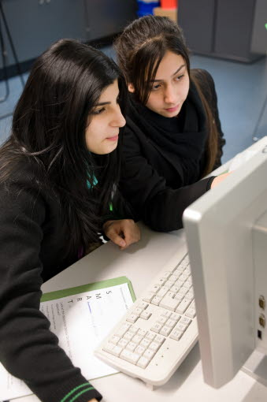
They had support from their peers
The successful children often had friends who offered practical or emotional support with school or learning. This helped them to enjoy school and to deal with difficulties. For example:
children helped each other out during lessons and advised on homework and helped with revision (providing informal peer tutoring).
Children who had failed to make good progress tended to have friends with negative attitudes to school and learning.

Slide 10
How you can use the evidence in this study
Could you look at the data in your school to identify pupils doing better than expected and consider why this might be?
How can you improve the positive self-image of children as learners?
What support do you provide for children experiencing difficulties to enable them to catch-up’?
What support do you provide for their parents to help children outside of school? How could this be enhanced?

Slide 11
Authors and Further Reading
Principal Investigators for the EPPSE project are: Kathy Sylva (Oxford), Edward Melhuish (Birkbeck), Pam Sammons (Oxford), Iram Siraj-Blatchford & Brenda Taggart (IoE).
This Research Bite draws on the EPPSE report:
Performing against the odds: developmental trajectories of children in the EPPSE 3-16 study, June 2011
A short summary (Research Brief) can be downloaded from the Department for Education website:
https://www.education.gov.uk/publications/eOrderingDownload/DFE-RB128.pdf
The full report is also available:
https://www.education.gov.uk/publications/eOrderingDownload/DFE-RR128.pdf

Slide 12
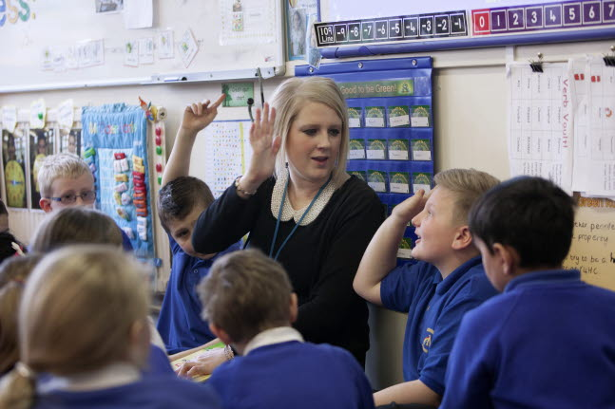
Further Information
EPPSE Website:
http://eppe.ioe.ac.uk
Or contact
Brenda Taggart
Principal Investigator and
Research Co-ordinator
00 44 (0) 207 612 6219
b.taggart@ioe.ac.uk

