Slide 1
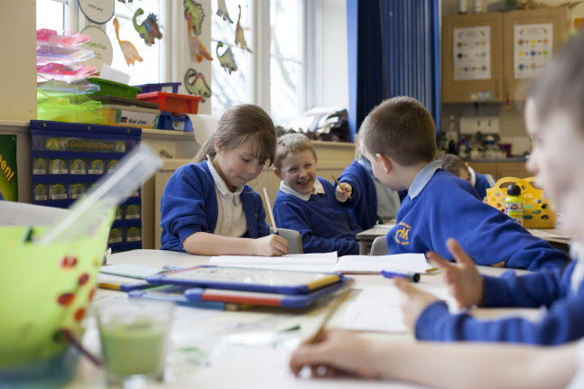
Effective Teaching Methods in 82 Primary Schools
Evidence from the
EPPSE project

Slide 2
What is EPPSE?
EPPSE is the Effective Pre-School, Primary and Secondary Education Project.
It is a longitudinal study that has followed 2,500 children from the age of 3 through pre-school, primary and secondary school. It examines how pre-school, school and home background relate to children’s achievements and behaviour.
The EPPSE project has also looked at the impact of teaching quality on pupils’ achievement, and the teaching behaviours in Year 5 classrooms which have an impact on pupil outcomes.

Slide 3
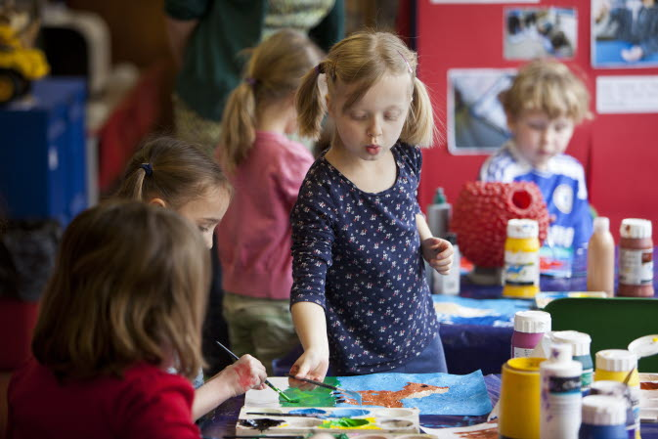
How was the information gathered?
The children were regularly assessed on their development from the age of 3. There have also been interviews with staff in pre-school and school, and assessments of the quality of pre-school and school environments.
This research on teaching methods draws mainly from observations of 82 Year 5 classes in 2004 and 2005 published in June 2011. It also draws on reports on Year 5 classroom practice and behaviour.

Slide 4
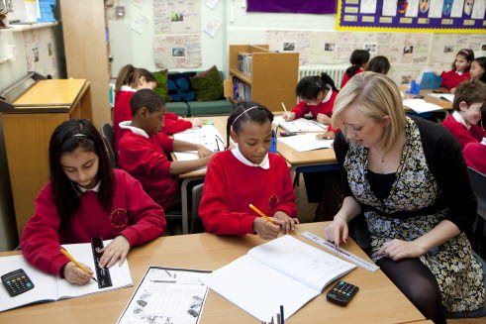
What the Study Found
The quality of teaching matters. There was considerable variation in the quality of teaching and pupil behaviour in Year 5 classrooms and this influenced outcomes in both Reading and Mathematics.
Teaching quality was a moderately strong predictor of improved Reading and Maths progress¹
There was a ‘bundle’ of behaviours that, taken together, distinguished the excellent from the good teachers, and which made a significant difference to children’s development and progress.
1 – The effect size for reading was 0.35, and for Maths 0.37. Effect size is a statistical concept that measures the strength of the relationship between two variables, controlling for other factors. For example, an effect size of 0.1 is relatively weak, one of 0.35 moderately strong, one of 0.7 strong.

Slide 5
Excellent teachers have good organisational skills
They share clear learning objectives with their pupils, ensure all pupils understand the objectives and associated concepts, have extremely well-organised resources and well-established classroom routines.
Excellent teachers ensured no time was wasted. Routines minimised disruption and maximised teaching time.
Children knew what to do and how long they had to do it. When children went ‘off-task’, teachers quickly regained their attention, sometimes using humour, and moved the lesson on.
Children were encouraged to be self-reliant and often responsible for managing their own time and resources.

Slide 6
Excellent teachers establish a positive classroom climate
These teachers develop relationships between children and adults which are characterised by a sense of liking and mutual respect
Excellent teachers seemed happy to be with their pupils and to enjoy the time they spent with them.
Children felt safe – both physically secure and safe enough to take risks associated with their learning (e.g. risking a wrong answer).
Children knew and respected the classroom rules and there was a sense of “friendly/firm control”.

Slide 7
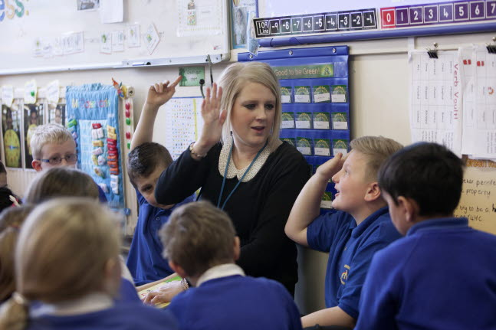
Excellent teachers personalise pupils’ learning
They are sensitive to the needs and interests of their pupils and provide a variety of resources to suit the individuals in their classes.
Excellent teachers knew each child as an individual and adapted their approaches and expectations according to their needs
They asked questions of specific children rather than choosing volunteers
They were more likely to make explicit the links between learning in the classroom and the world outside the classroom and provide homework directly linked to what children are learning in their lessons

Slide 8
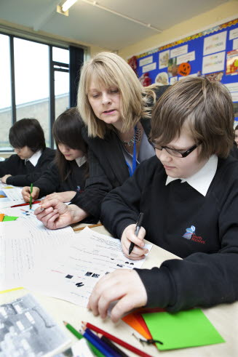
Excellent teachers use ongoing talk between teacher and pupils, not just presentations
They use ‘dialogic teaching’ which encourages more in-depth understanding. Children work collaboratively and have opportunities to receive feedback
Excellent teachers ensured pupils were involved in collaborative group work to solve problems and comment on each other’s work
They asked the children to explain concepts and ideas, particularly in mathematics
They provided evaluative feedback and children had opportunities to reflect on their learning. Children felt free to ask questions and to discuss their work with each other and with their teacher

Slide 9
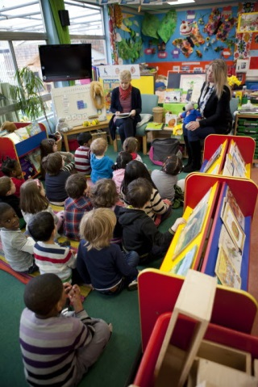
Excellent teachers make more frequent and better use of the plenary
They are twice as likely to use a plenary, and they use it to provide feedback and to allow further discussion, exploration and extension. Excellent teachers used plenaries:
to informally assess children’s understanding of basic concepts and skills and consolidate their learning;
to provide an opportunity for children to share their work and receive feedback;
to resolve issues arising from the lessons, provide a forum for collaborative problem solving and forward planning.

Slide 10
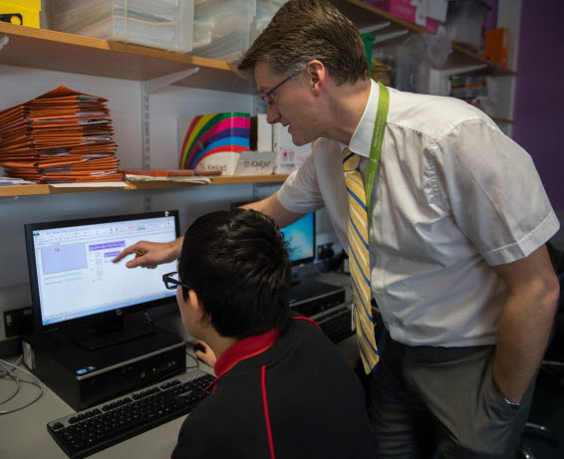
How you can use the evidence in this study
Which elements do you recognise in your classrooms?
How can you adapt your teaching or classroom routines?

Slide 11
Authors and Further Reading
Principal Investigators for the EPPSE project are: Kathy Sylva (Oxford), Edward Melhuish (Birkbeck), Pam Sammons (Oxford), Iram Siraj-Blatchford & Brenda Taggart (IoE).
Short summaries of the research reported here (‘Research Briefs’) can be downloaded from the Department for Education website:
Effective Primary Pedagogical Strategies in English and Mathematics in Key Stage 2: A study of Year 5 classroom practice drawn from the EPPSE 3-16 longitudinal study (2011)
http://www.education.gov.uk/publications/eOrderingDownload/DFE-RB129.pdf
Variations in Teacher and Pupil Behaviours in Year 5 Classes (2006), Research Brief RB817.
http://www.education.gov.uk/publications/eOrderingDownload/RB817.pdf
The Influence of School and Teaching Quality on Children’s Progress in Primary School. (2008) Research Brief RB028 http://www.education.gov.uk/publications/eOrderingDownload/DCSF-RB028.pdf
Full reports of the research are also available on the DfE and the EPPSE websites.

Slide 12
Further Information
EPPSE Website:
http://eppe.ioe.ac.uk
Or contact
Brenda Taggart
Principal Investigator and
Research Co-ordinator
00 44 (0) 207 612 6219
b.taggart@ioe.ac.uk

