Slide 1
What makes a successful transition from Primary to Secondary School ?

Slide 2
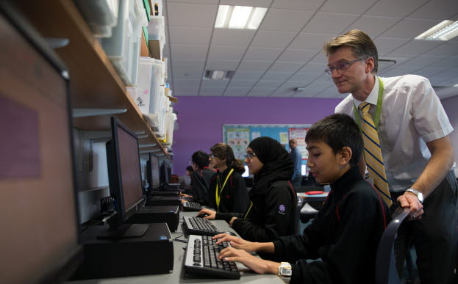
Key issues addressed by the study
This UK study:
explored current transition practices
highlighted what helped and hindered successful transition between KS2 and KS3

Slide 3
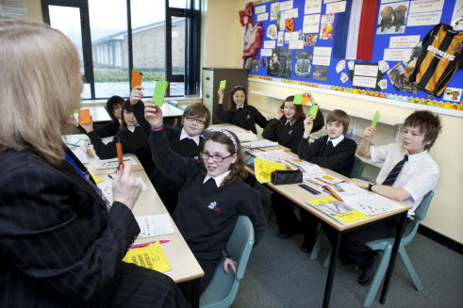
Parents and pupils’ views
Parents and pupils thought successful transition involved:
building new friendships and improving self esteem
showing increased interest in school and school work
getting used to new routines and organisation
experiencing curriculum continuity

Slide 4
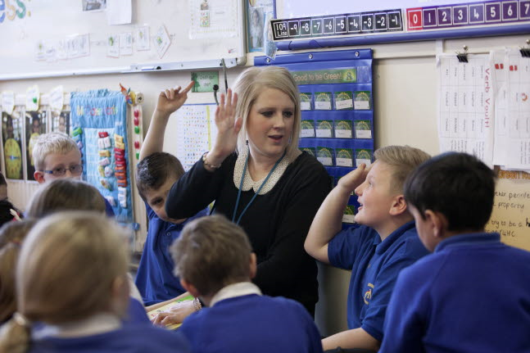
Schools’ support for pupils during transition
Effective activities used by schools included:
group and pair work
seating arrangements to help build friendships
team-building activities
visits of teachers to the Year 6 pupils in June-July
sharing views with parents

Slide 5
Perceived barriers to successful transition
For children, poor transition was associated with:
experiences of bullying
worrying about doing well or making new friends and feeling included
having new and different teachers for each subject

Slide 6
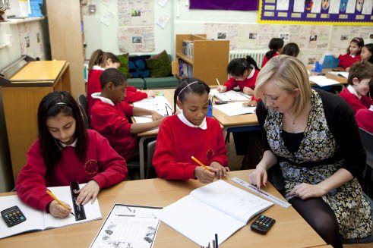
What local authorities saw as problems for transition
According to local authority officers, transition problems occurred when:
parents did not understand the admissions process well, especially if neighbouring authorities had different procedures
parents tried to manipulate the system

Slide 7
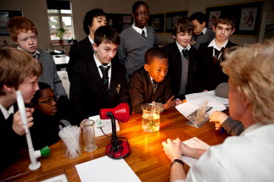
What schools saw as the main obstacles to successful transition
Secondary schools not having enough information about each child
Primary schools lacking knowledge of processes and procedures at secondary schools

Slide 8
Who were the children in the study?
550 children and their families were involved in the study which was a sub-study of a larger study

Slide 9
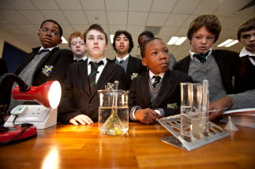
How was the information gathered?
The methods used included:
interviews with officials in six LAs
a survey of children and their families
production of 12 case studies of pupils who experienced good transition

Slide 10
How can teachers use this evidence?
The study found developing new friendships and settling well was very important to pupils during transition. How could you support the children in this?
Would it be helpful to consider relationship building when, for example planning and organising group work and classroom seating arrangements?
Would it be helpful to organise mentor or buddy arrangements for new pupils in need of support?

Slide 11
How can school leaders use this evidence?
The research highlighted the importance of information exchange prior to transition
How can you encourage colleagues to work more closely with colleagues from other phases to facilitate smoother transition?
Could you discuss with your staff different approaches to involving parents?
The research showed that bullying worried many pupils during transition
What strategies do you use to combat these such fears?

Slide 12
Follow-up reading
Study reference:
Evangelou, M., Taggart, B., Sylva, K., Melhuish, E., Sammons, P. and Siraj-Blatchford, I. (2008)
What makes a successful transition from Primary to Secondary School? DCSF, 2008, Research Report DCSF – RR019
You might like to read a more detailed summary of this research, accessible at:
http://www.standards.dfes.gov.uk/research/themes/transition/successfultransition/

Slide 13
Feedback
Did you find this useful?
What did you like?
What didn’t you like?
Any feedback on this Research Bite
would be much appreciated. Please email
your feedback to:
research.summaries@dcsf.gsi.gov.uk

