Slide 1
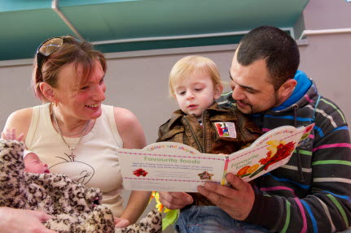
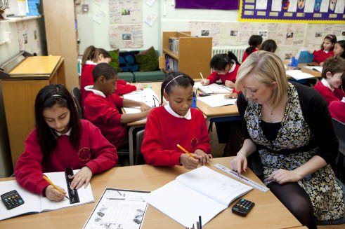
Home and pre-school influences on early language and reading
Evidence from the Effective Pre-school, Primary and Secondary Education (EPPSE) project

Slide 2
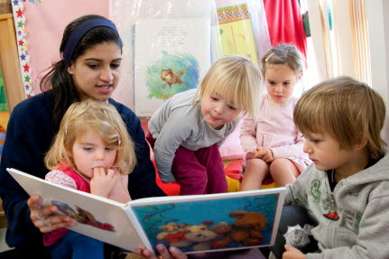
Supporting early reading
This Research Bite looks at:
The effects of home learning environments on later literacy outcomes.
The effects of pre-school environments on later literacy outcomes.

Slide 3
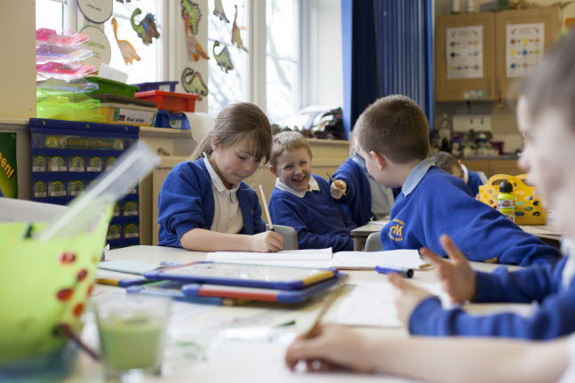
The EPPSE study
EPPSE is a longitudinal study that has followed more than 2,500 children from the age of 3 through pre-school, primary and secondary school.
The EPPSE project seeks to investigate:
The influence of pre-school, primary and secondary schooling on academic, social-behavioural and affective development from age 3 to 16+.
The relationship between individual child, family and home learning characteristics and student’s educational attainment at different ages.
EPPSE is a comprehensive study which looks at many factors and influences on children’s educational experience, and in the process has gathered extensive information on children’s developmental trajectories in language and reading.

Slide 4
Setting the scene
Early development of literacy skills, before children arrive at school, is shaped by what children learn at home and what they learn in pre-school settings.
We already know that background characteristics such as socio-economic status and the level of mother’s qualifications impact on children’s literacy development.
However taking account of background characteristics such as these, children who have a good home learning environment (HLE), and who attend high quality pre-school, have better language development when they start primary school and make more progress than their peers over the primary school period.
What is it about learning at home and pre-school that creates this advantage?

Slide 5
Development of reading skills
There are two different but equally important skills which are necessary for early reading:
Decoding – the ability to apply a knowledge of letter-sound relationships to correctly recognise written words. This includes:
Letter knowledge
Phonological awareness (a child’s ability to recognise the sound structure of spoken words)
Oral Language – the stock of words known, understood and used by a child. This includes:
Naming vocabulary
Verbal comprehension

Slide 6
Home learning in the early years
EPPSE research has examined learning opportunities in the home, and has identified several activities which make for a better early home learning environment (HLE), including:
being read to;
painting and drawing;
going to the library;
playing with letters and numbers;
learning activities with the alphabet;
learning activities with numbers and shapes;
learning activities with songs, poems and nursery rhymes.

Slide 7
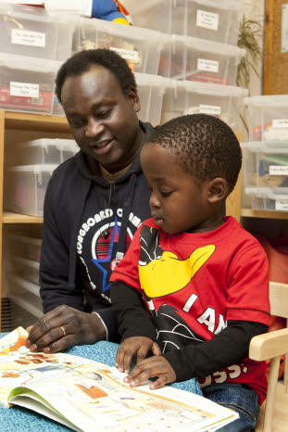
Home learning in the early years
Between the ages of 3-5, development of code-related skills is influenced by:
Engaging in learning activities with the alphabet (Effect Size*=0.51)
Playing with letters and numbers (ES⃰ =0.36)
Between the ages of 3-5, development of vocabulary skills is influenced by:
Being read to daily (ES*=0.27)
Learning songs, poems and nursery rhymes (ES*=0.20)
Visiting the library often (ES*=0.18)
These influences persist throughout primary school. Children with a strong early years HLE made greater gains over 4 years of primary school (ES 0.30).
⃰ES, or Effect Size shows statistically the strength of the relationship between an outcome such as National Assessment scores and another variable such as HLE, while controlling for other factors.
An effect size of 0.1 is relatively weak, one of 0.35 is moderately strong, while one of 0.7 is very strong.

Slide 8
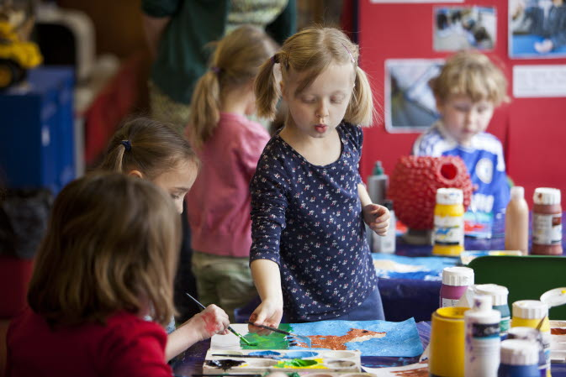
Attending pre-school improves early literacy
Impact on code-related skills:
Attending pre-school improves code-related skills (ES=0.30).
The more months spent in pre-school the better a child’s code-related skills (ES=0.33).
The more months a child spends in high quality pre-school, the better their code related skills (36+ months, ES=0.62).
Impact on oral language skills:
Attending pre-school improves language skills (ES=0.42).
The more months spent in pre-school the better a child’s language skills (ES=0.14).
The more months a child spends in high quality pre-school, the better their language skills (36+ months, ES=1.01).
Point 2
Children have better language development in pre-school if there is a mix of children from advantaged and disadvantaged backgrounds (measured by mother’s qualifications) for both code-related skills (ES 0.24) and vocabulary skills (ES 0.19). This may be due to a peer effect as well as staff using more challenging activities and having higher expectations of all children.

Slide 9
The quality of pre-school is important
One year in a high quality pre-school (ES 0.38) has a similar positive impact on early literacy (pre-reading) as 2+ years in a low quality pre-school (ES 0.37).
2+ years in a high quality pre-school has the biggest impact (ES 0.62) on early literacy (pre-reading).
Only pre-schools of medium or high quality have a lasting impact on literacy in primary school.
Inadequate | Minimal | Good | Excellent
- Few or no rhymes or poems are spoken or sung | - Rhymes are often spoken or sung by adults to children - Children are encouraged to speak and/or sing rhymes | - The rhyming components of songs or rhymes are brought to the attention of the children - The initial sounds in words are brought to the attention of the children | - Attention is paid to syllabification of words (i.e. through clapping games, jumping) - Some attention is given to linking sounds to letters
What determines quality in pre-school with regards to emergent literacy?
Here is an example of use of rhymes*.
*Early Childhood Environment Rating Scale- Extension (ECERS-E) - Sylva, Siraj-Blatchford & Taggart, 2010

Slide 10
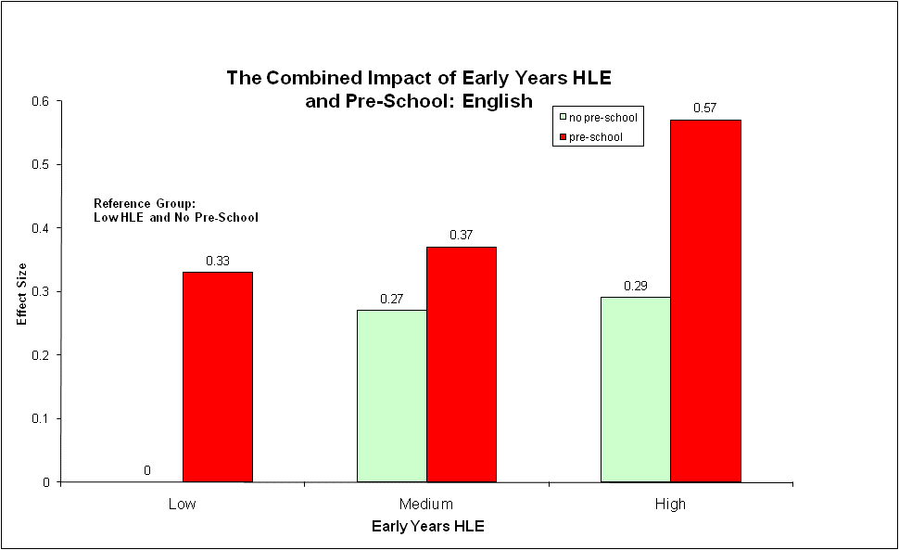
Combined effect of early home learning and pre-school
Both early home learning and pre-school influence early literacy. However:
The early years HLE has more impact than pre-school on the development of oral language, especially vocabulary skills.
Pre-school is more likely to influence code-related skills (especially high quality pre-school).
Overall, early home learning and pre-school have a positive effect on attainment in English that is still apparent when children are in primary school (aged 11).
Attendance at pre-school combined with a high level of early home learning has an Effect Size of 0.57.
Final report of from the primary phase - Sylva, Melhuish, Sammons, Siraj-Blatchford and Taggart 2008

Slide 11
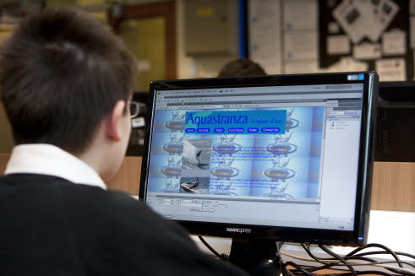
The impact of home learning in KS1
Unlike the early years HLE, doing more at home during KS1 is not necessarily better:
If a child is a poor reader, reading to them in KS1 has very little effect on their reading scores, but listening to them read does (ES=0.10).
Too much time spent by a child on home computing was also related to poorer outcomes. High levels of ‘home computing’ (compared to low or moderate levels) are associated with lower attainment in English (ES=0.17 for low use; ES=0.18 for moderate use, and ES=0.05 for high use). This may be because very high levels of home computing may replace or displace reading and other activities, especially for boys.

Slide 12
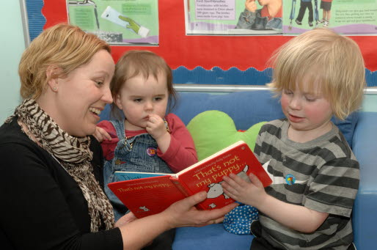
Take home messages
A good early years home learning environment has a strong positive effect on children’s early literacy and later reading.
The effect of early years home learning persists throughout primary school.
Home learning develops both vocabulary and code-related skills. Different activities shape the development of different skills.
Development of vocabulary skills is more reliant on the home environment. Pre-school also has an impact on vocabulary, but tends to have more impact on the development of code-related skills.
The quality and the amount of pre-school children receive is important.

Slide 13
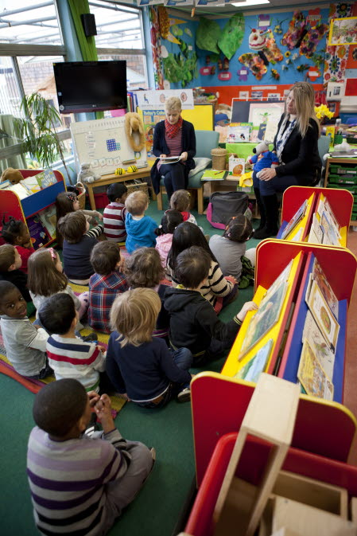
Further Information
Principal Investigators for the EPPSE project are:
Kathy Sylva - University of Oxford
Edward Melhuish - Birkbeck, London
Pam Sammons - University of Oxford
Iram Siraj-Blatchford - Institute of Education, London
Brenda Taggart - Institute of Education, London
EPPSE Website:
http://eppe.ioe.ac.uk
Or contact
Brenda Taggart
00 44 (0) 207 612 6219
b.taggart@ioe.ac.uk

